Slide 1
A complete system to detect and stop cyberbullying Along with Personalized automatic mental health counseling for the victims
CSE299​

Slide 2
MEET OUR TEAM
Farhana akbar
Farhan Ishrak tahmid​
ID: 2012482042
ID: 2031458642

Slide 3
Introduction
A complete system that can stop cyberbullying. This system will be working with institutions and organizations to detect cyberbullying cases in different forms, keep records of the victims and bullies and take actions centrally if needed. Also the system can provide personalized counselling to victims.

Slide 4

Cyber-bullying
Cyberbullying includes sending, posting, or sharing negative, harmful, false, or mean content about someone else. It can include sharing personal or private information about someone else causing embarrassment or humiliation. Some cyberbullying crosses the line into unlawful or criminal behavior.

Slide 5
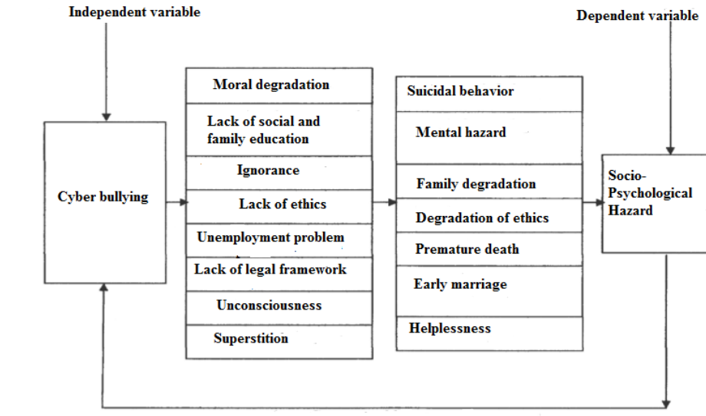
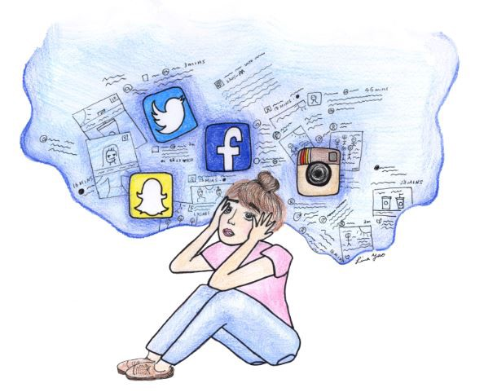
Effect of cyber-bullying

Slide 6
AGENDA
Detection
Counseling
​Monitoring
Multi-language
Complete system
​

Slide 7





Our PLAN?
Bullying detection
language
counseling
monitoring
Complete system
Image
Text
Voice
Bangla
English
Victim will get counseling centrally.
Monitoring period of bully.
Complete Organizational system.

Slide 8
Previous works
Application-Systems
No application is available right now to stop and keep a record of cyberbullying through institutions and control them centrally. There are applications for separate use-cases.

Slide 9
Background research
journals
Some journals are available to detect cyberbullying through texts, but mainly for the English Language. But there haven’t been any works where we can detect cyberbullying through several media like texts, images, and voice in Bangla Language.

Slide 10
Background research
Supporting datasets
A paper has been published to detect cyberbullying through Bangla Texts. An accuracy of 96% has been recorded with KNN(1st nearest), which was mentioned in the published paper titled, “https://ieeexplore.ieee.org/document/8636797/authors#authors”

Slide 11
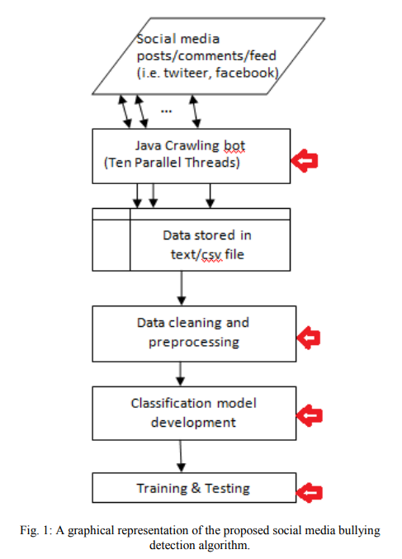
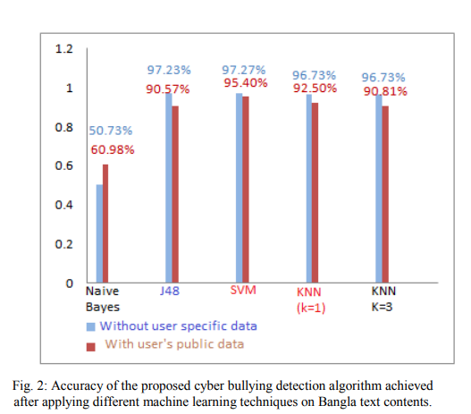
Social media bullying detection using machine learning on Bangla text 10th International Conference on Electrical and Computer Engineering 20-22 December, 2018, Dhaka, Bangladesh
Used model
Recorded Accuracy

Slide 12


Continued
classification
Limitation
Public posts/comments
Favourite count
Post time
Re-Tweet count
User status count
User public description
Follower count
Friends count
Location
Screen name
Only recognizes text-based bullying
Only based on 1000 data
Not trained on large datasets yet.

Slide 13
Effectiveness of a Counselling Program to Improve Self-Concept and Achievement in Bully-Victims Review of European Studies · May 2015
Abstract
Discussion
This study aimed to investigate the effectiveness of a counseling program on the self-concept and achievement
behavior of bully victims. To realize the aim of the study, self-concept and bullying behavior scales and a group
counseling program based on CPT were applied.
The purpose of this study was an improvement in the self-concept, social skills, and coping ability of bully victims
among the experimental group pupils, who fitted the pupil bully target mold as identified in the literature. The
t-test results showed significant differences between the experimental and control groups in changing the
behavior of bully-victims. The experimental group identified and accepted responsibility for their emotions,
exploring different and acceptable ways of expressing their feelings, especially anger.

Slide 14
THANK YOU
Any questions?

